Slide 1
THE SILENT KILLER
Margaret Polen, Past National FCE President

Slide 2
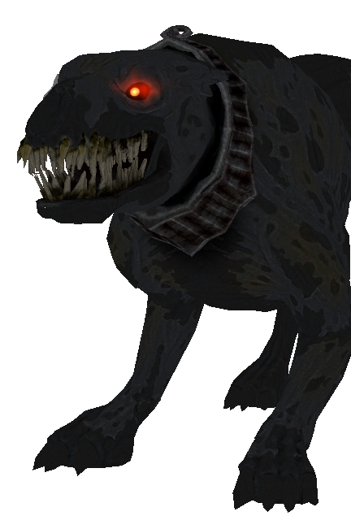
ANNUALLY
12,810 lives in the U.S.
207,000 lives globally

Slide 3
OUR O’S

Slide 4
WHAT an OVARY RESEMBLES

Slide 5
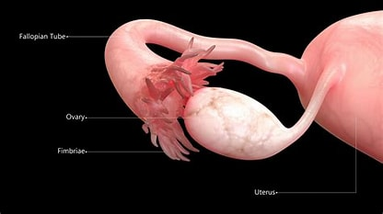

Slide 6
PROJECTION for 2040, World
Diagnosis with ovarian cancer will rise by 37%
Dying from ovarian cancer will rise 50%

Slide 7
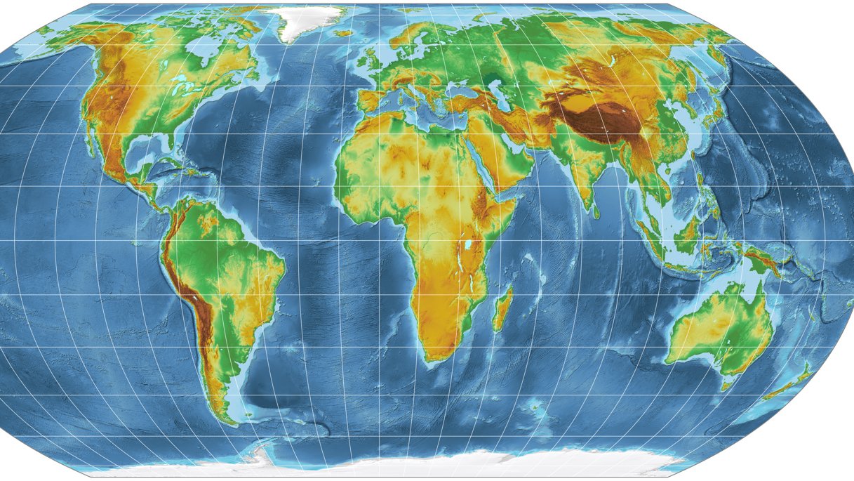
7th most common cancer in women—worldwide
8th most common cause of death in women—worldwide
5th most common cause of death in women—U.S.
Accounts for more deaths than any other cancer of female reproductive system in U.S.

Slide 8
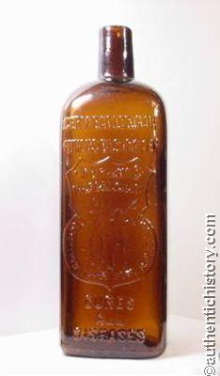
HOW ARE YOU FEELING??
Tired
Abdomen Feeling Swollen
Stomach Upset Back Hurts
Bloated

Slide 9
SYMPTOMS
Fatigue
Upset stomach
Back pain

Slide 10
Pain during sex
Constipation SILENT
Changes in period
Abdominal swelling with weight loss

Slide 11
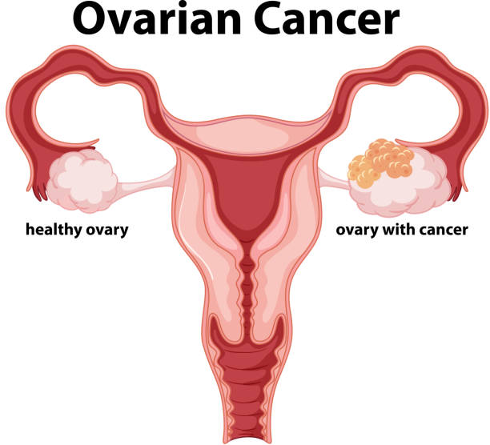
OVARIAN CELLS
Epithelial
Ovarian Germ Cell
Ovarian Stromal Tumors

Slide 12
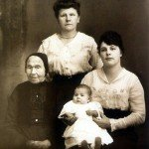
RISKS
Getting Older
Being Overweight or Obese
Taking Hormone Replacement Therapy (HRT)

Slide 13
Risks, continued…
Family History
Family Cancer Syndrome
Hereditary Breast & Ovarian Cancer Syndrome (HBOC)

Slide 14
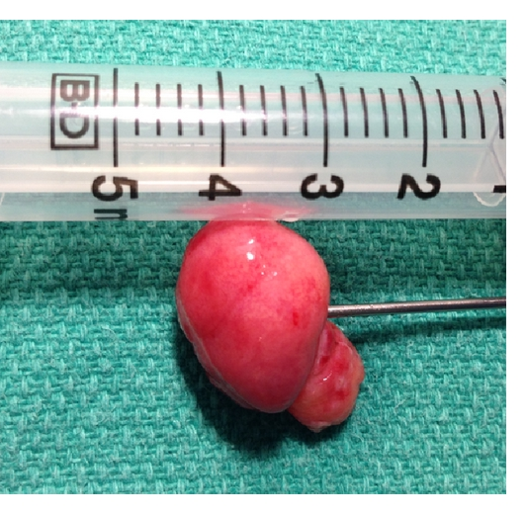
More Risks…
Hereditary Nonpolyposis Colon Cancer
Peutz-Jeghers Syndrome
MUTYH-Associated Polyposis

Slide 15
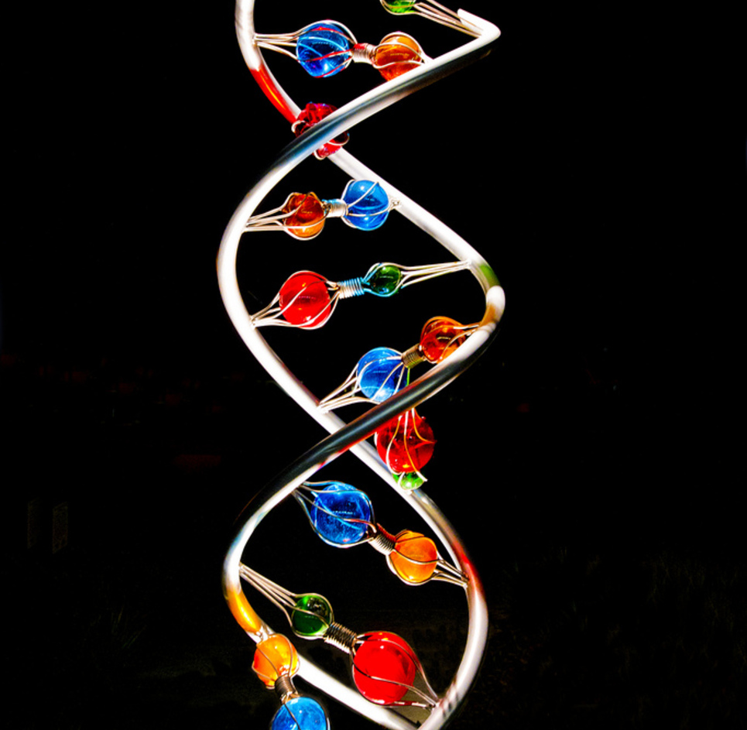
More…
Other Hereditary Ovarian Cancer Genes
Use of Fertility Treatments
Have Had Breast Cancer

Slide 16
Lastly…
Smoking
Testosterone, talcum powder, & diet

Slide 17
TESTING
Annual Exam
Tell Provider Your Risk Factors
Ultrasound, CT scan, Upper/Lower GI, MRI,
PET scan & X-rays

Slide 18
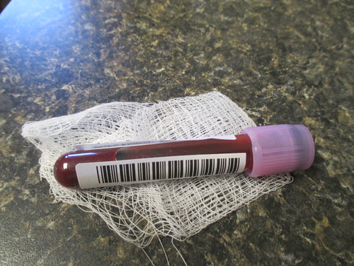
THEN…
Laparoscopy
Colonoscopy
Biopsies
Blood Tests

Slide 19
PREVENTION
No Hormone Replacement Therapy
No Smoking
Keep Weight Down & Eat Healthy

Slide 20
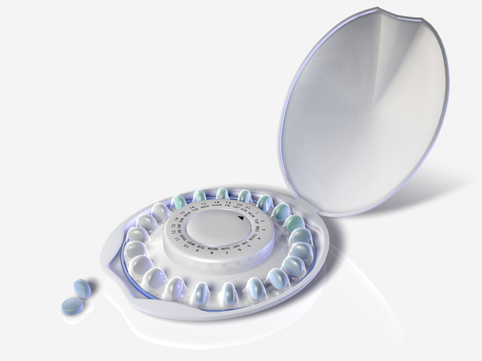
MORE to do…
Take Oral Contraceptives
Tubal Ligation and/or Hysterectomy
BRCA Positive? Remove Ovaries

Slide 21
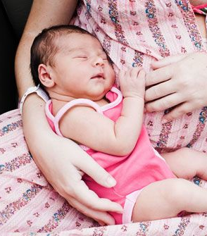
A Few More Things to Do…
Get pregnant before 40, but not as young teen
Breast feed your baby

Slide 22
WHAT STAGE ARE YOU AT?

Slide 24
OVARIAN CANCER AWARENESS
SEPTEMBER
TEAL

Slide 25
NO WOMAN LEFT BEHIND

